Slide 1
EXPLORATORY DATA ANALYSIS IN R

Slide 2
Measures of Central Tendency :MEAN , MEDIAN, MODE
CENTRAL TENDENCY
MEAN, MEDIAN,MODE
MEAN: SIMPLE AVERAGE
OBTAINED BY ADDING ALL SAMPLES DIVIDING BY TOTAL NUMBER
AFFECTED BY OUTLIERS

Slide 3
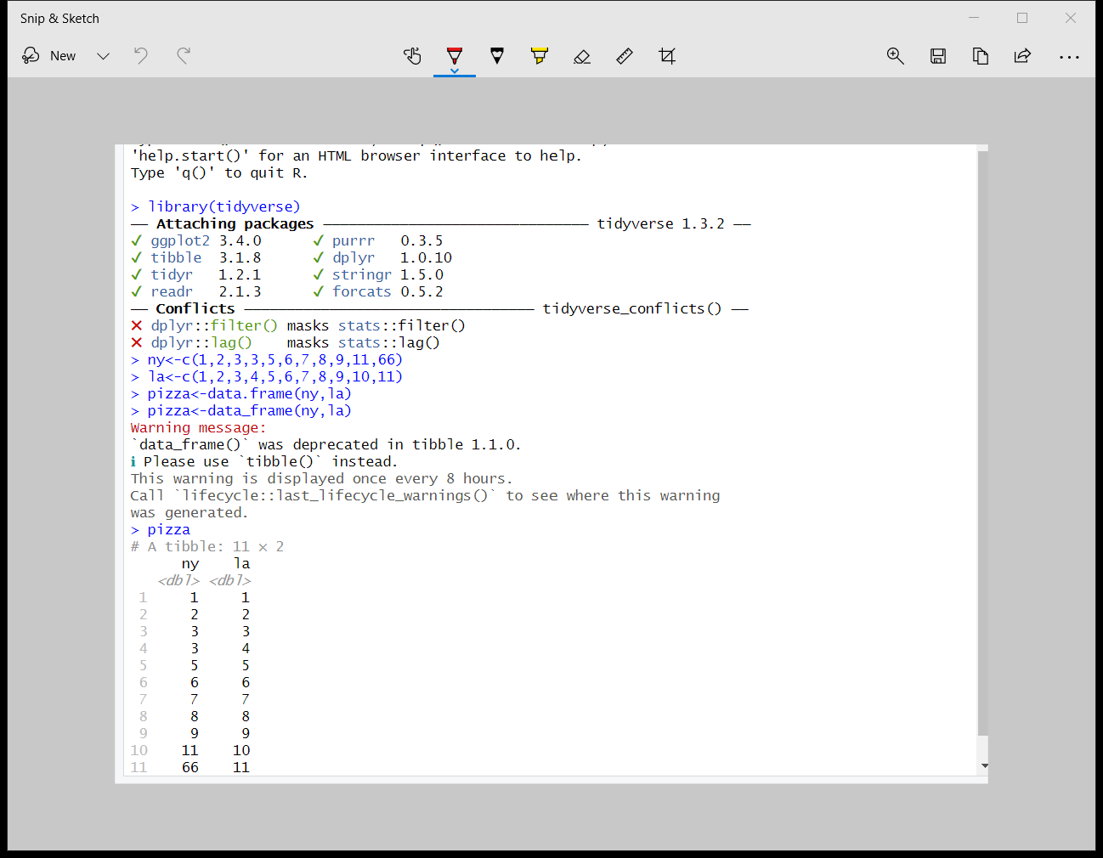
CREATING A DATAFRAME CALLED PIZZA AND CALCULATING MEAN , MEDIAN, MODE
library(tidyverse)
##Creating a dataframe to store pizza prices in 11 different locations in ny and la##

Slide 4
Calculating mean, median,mode
One very costly sample increased the mean value. So not accurate!
So go for median .. Middle value in ordered dataset. This is not affected by ouliers but doesn’t answer the question are majority of restaurants low cost or high cost
Mode – The value that occurs the most often. No built in function
So we create a contingency table using table function and use the which function to find the most frequently used value
Contingency table shows the frequency distribution of the data
Mostly used with categorical data

Slide 5
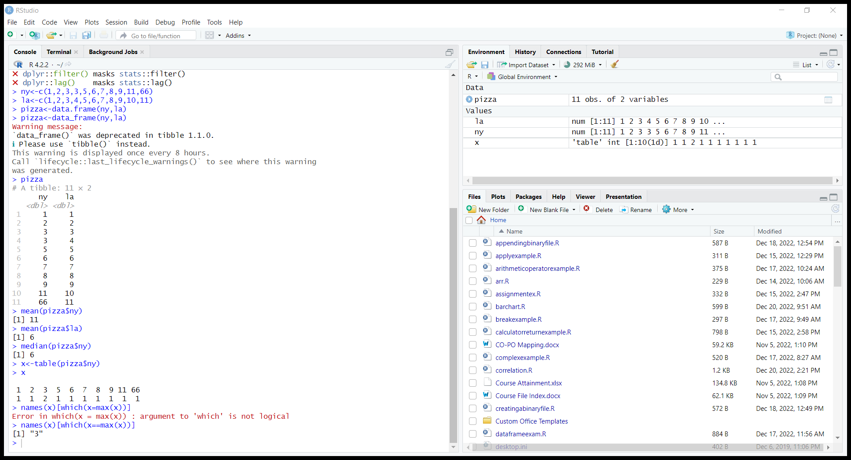
Try the Code

Slide 6
Measures of Asymmetry: Skewness
Create a dataframe
Call summary to know each columns mean , median values
Then use ggplot to draw the histogram in order to visualize the skew
In summary note that column 1 has a mean of 4.3 and a median of 4.5 which shows mean< median then it is said to be negative skewed(left skew)
When mean>median then it is said to be positive skewed(right skew)
Skew is important because it tells us where the data is located

Slide 7
Exercise
Load the two data sets into R: “skew_1.csv”, and “skew_2.csv”.
Identify the skew of the data sets, both visually, and numerically.
Try to interpret what you are seeing.

Slide 8
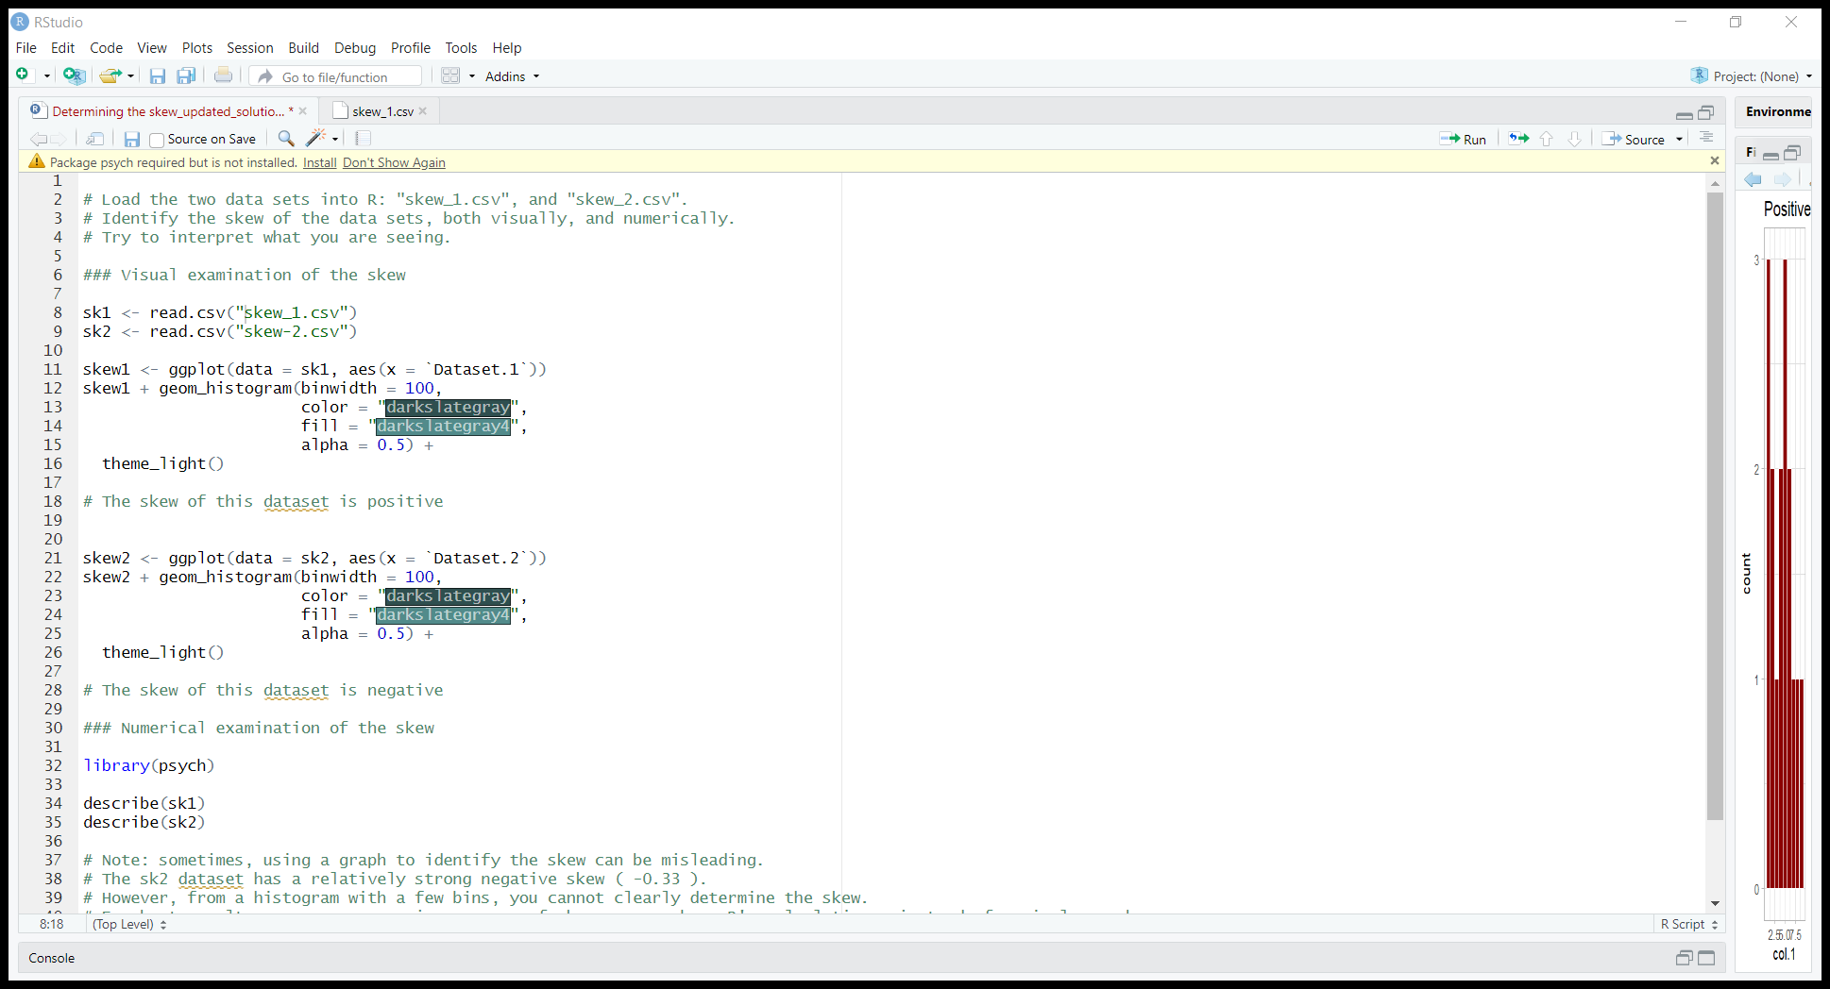
Try this!!

